Slide 1






A new generation
of tech specialists

Slide 2
Roshnayi (Enlightenment)
Predictive Modeling for Counterterrorism:
Machine Learning Algorithms for
Anticipating Targets of terrorist
attacks in Afghanistan.

Slide 3
Outline
Concept note and implementation plan:​
Background​
Objectives​
SDG Relation​
Data​
Data Collection​
Exploratory Data Analysis (EDA) and Feature Engineering​
Model Selection and Training​
Model Evaluation and Hyperparameter Tuning​
Model Refinement and Testing​
Results​
Deployment​
Future Work

Slide 4
Concept Note and Implementation

Slide 5
Background
This project aims to develop predictive models using machine learning algorithms to anticipate the targets of terrorist attacks in Afghanistan.
The primary problem addressed is the high incidence of terrorist attacks in Afghanistan and the need for improved predictive tools to aid in counterterrorism efforts.

Slide 6
Background
Afghanistan has been severely affected by terrorism particularly over the past two decades, posing significant challenges to peace and security.
In the global terrorism index report for 2022, Afghanistan was ranked first among countries with a very high impact of terrorism, scoring 9109 points.
Developing predictive models that can anticipate potential terrorist attack targets can help counterterrorism efforts.

Slide 7
Objectives
Develop machine learning models to predict potential terrorist attack targets in Afghanistan.
Visualize regions and patterns of vulnerability to aid in proactive counterterrorism measures.
Provide actionable insights to enhance the effectiveness of counterterrorism strategies in Afghanistan.

Slide 8
SDG Relation
This project aligns with Sustainable Development Goal (SDG) 16: Peace, Justice, and Strong Institutions by constructing predictive models capable of offering actionable insights for counterterrorism efforts.

Slide 9
Data

Slide 10
Data Collection
The Global Terrorism Database (GTD) documents terrorist attacks worldwide from 1970 to the present, with the most recent data available up to June 2021.
Contains information on over 200,000 terrorist attacks.
The dataset includes 135 attributes for each entry, covering various aspects such as country, year, casualties, and weapons used.

Slide 11
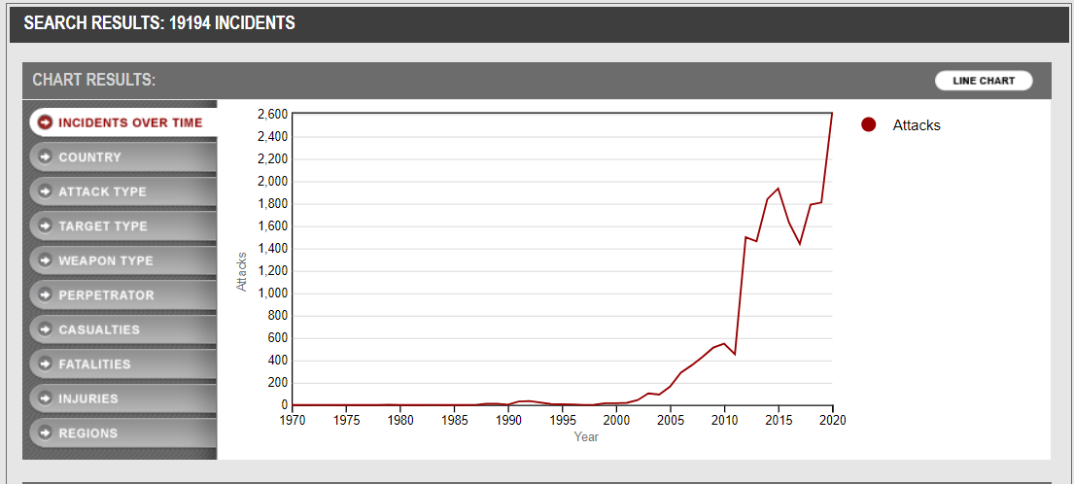
Data Collection
Afghanistan data was extracted and used in this project, contains more than 20,000 terrorist attacks.

Slide 12
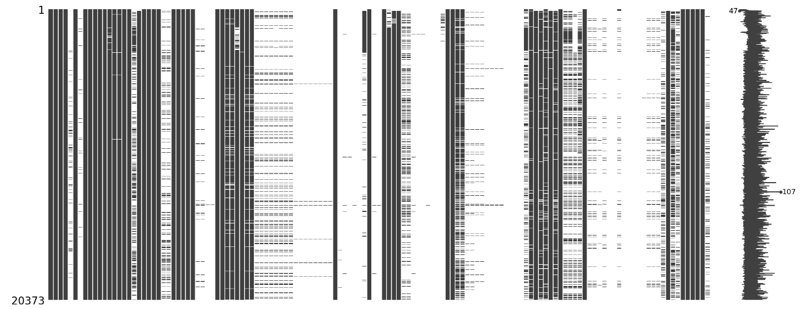
Data Collection
Missing value matrix

Slide 13
Data Collection
Data cleansing involved removing attributes with more than 50% missing values.
Following the guidelines in the Global Terrorism Database Guidance Manual, we filled the missing values in specific attributes with the appropriate corresponding values.

Slide 14
Exploratory Data Analysis (EDA) and Feature Engineering
The correlations between attribute fields are analyzed using methods such as covariance correlation, Pearson correlation, and Kendall correlation.
Four features, i.e., longitude, latitude, fatalities, and injuries, were standardized by the StandardScaler object method.
I performed type conversion and feature transformation to prepare our data for machine learning models. Specifically, we apply one-hot encoding to categorical features and equal-width binning to numerical features.
In this project, I use a new SelectKBest method in scikit learn to select best 10 features.

Slide 15
Model

Slide 16
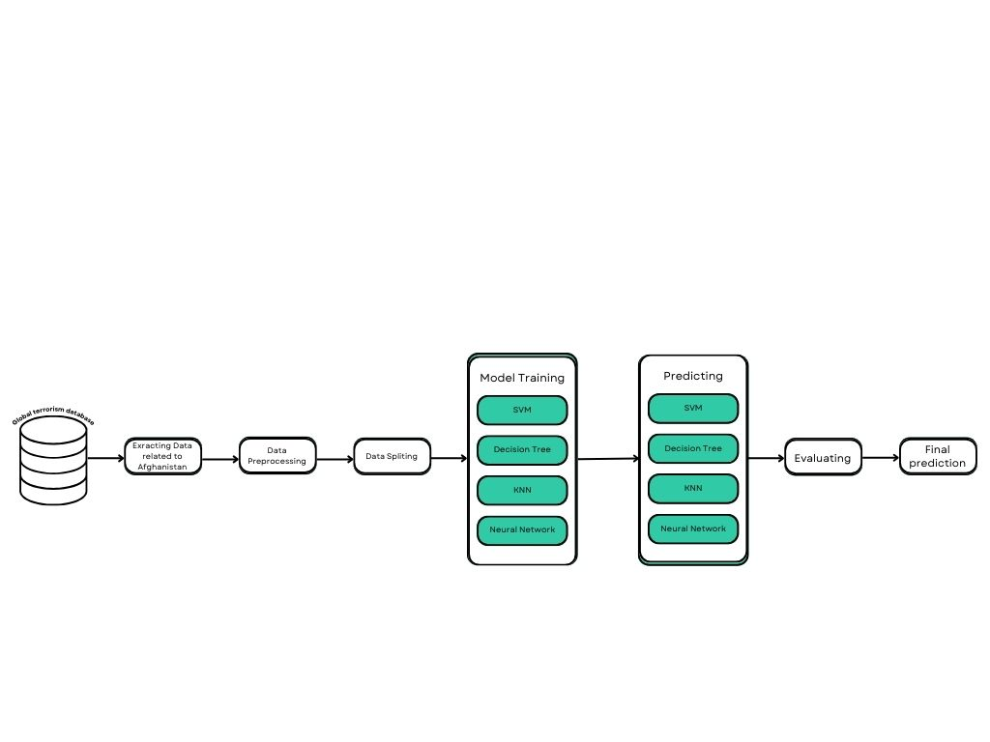
Model Selection and Training
Several models trained in this project:
Support Vector Machines (SVM)
Decision Trees
k-Nearest Neighbors (KNN)
Deep Neural Networks (DNN).

Slide 17
Model Selection and Training
For this project Decision Trees was selected due to its higher accuracy and effectiveness for classification.
Strengths:
Highly interpretable and easy to understand.
Can handle both numerical and categorical data.
Provides feature importance.
Weaknesses:
Prone to overfitting, particularly with noisy data.
Instability: small changes in data can lead to different tree structures.

Slide 18
Model Evaluation and Hyperparameter Tuning
Each model was trained on a dataset focused on predicting targets of terrorist attacks using the Global Terrorism Database (GTD). The models were evaluated based on accuracy, precision, recall, and F1-score.
The decision tree model, for example, achieved high accuracy and was further refined through hyperparameter tuning.
Hyperparameter tuning involved adjusting parameters such as the criterion, max depth, min samples split, min samples leaf, and max features for the Decision Tree model.
Techniques such as RandomizedSearchCV and GridSearchCV were used for finding the best parameters.

Slide 19
Model Refinement and Testing
Techniques used for model improvement
Hyperparameter Tuning: RandomizedSearchCV and GridSearchCV for parameter optimization.
Feature Selection: SelectKBest for top 10 features based on importance scores.
Cross-Validation: Employed 3-fold cross-validation for robust evaluation.

Slide 20
Model Refinement and Testing
Overview of the test submission phase
The test dataset was derived from the main dataset using an 80/20 train-test split.
The trained Decision Tree model, after grid search optimization, was applied to the test dataset.
Metrics and results on the test dataset
Accuracy: 0.99
Precision: 0.97
Recall: 0.96
F1-score: 0.97
These results indicate that the Decision Tree model is robust and reliable

Slide 21
Result

Slide 22
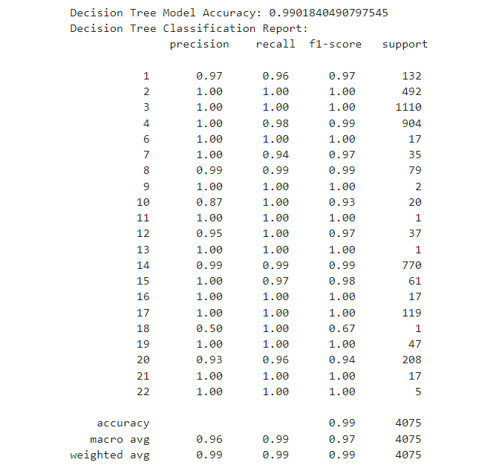
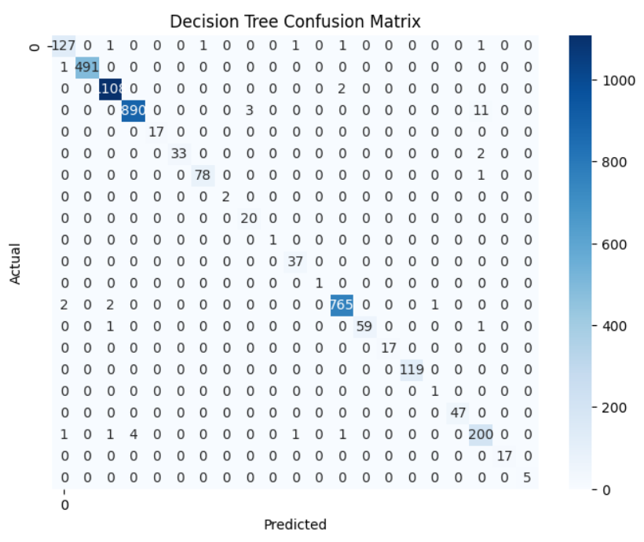
Evaluation Results

Slide 23
Deployment

Slide 24
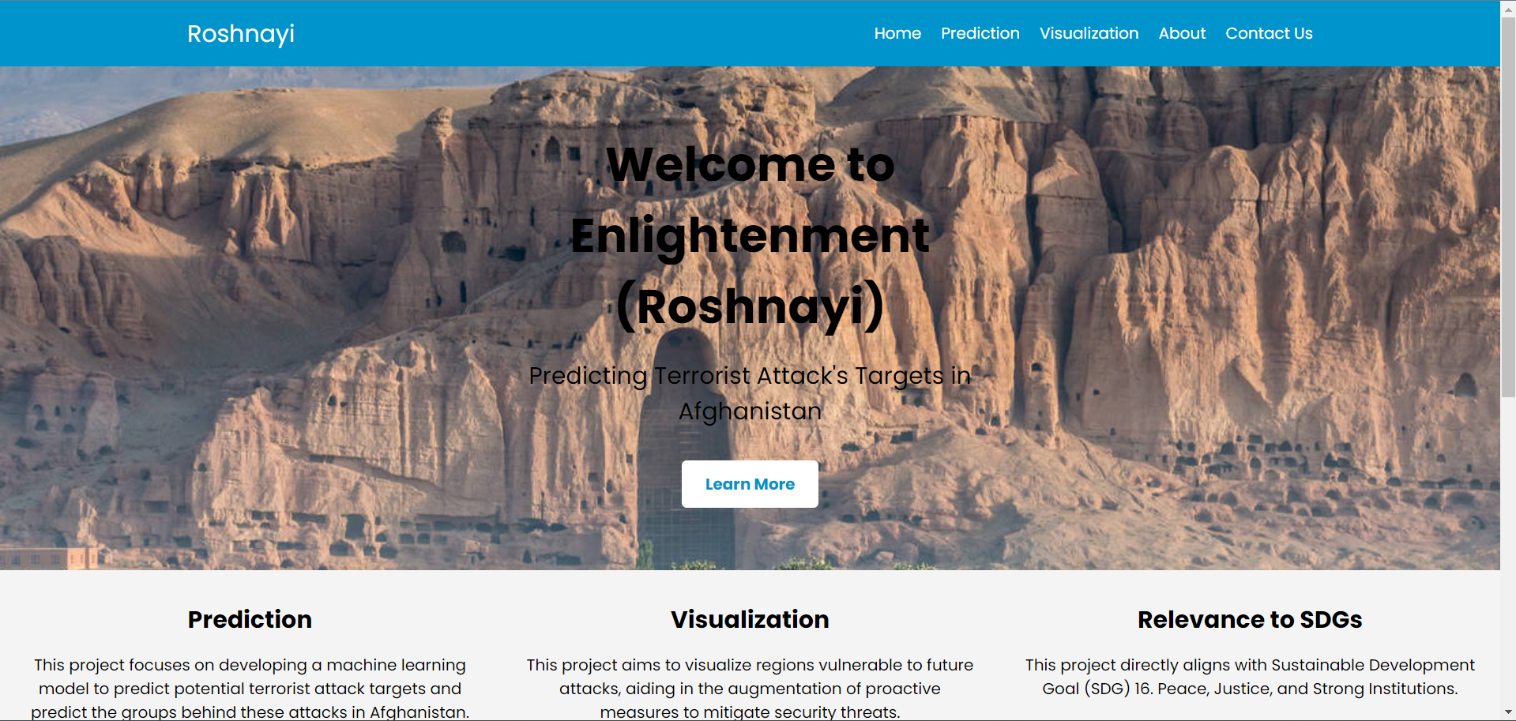
Deployment

Slide 25
Conclusion and Futurework
Visualize the vulnerable areas on map and add them to the website
Collect more data
Retrain the model

Slide 26

Thank you!

